Slide 1
Capstone Project
Health insurance cross sell prediction Bhaskar Subanji

Slide 2
Content
Data Summary
Analysis Of Data
Challenges
Conclusion

Slide 3
Problem statement
Predict Health insurance owners' who will be interested in buying Vehicle Insurance :
Our client is an Insurance company that has supplied Health Insurance to its customers now they require help in building a model to predict whether the consumers from the past year will also be interested in Vehicle Insurance provided by the company.

Slide 4
Python Modules/Packages/Libraries.
Let us begin our analysis by loading the above mentioned Python Modules/Packages/Libraries.
# importing libraries
import pandas as pd
import numpy as np
import seaborn as sns
import matplotlib.pyplot as plt
from sklearn.preprocessing import LabelEncoder
from sklearn.model_selection import train_test_split
from imblearn.over_sampling import RandomOverSampler
from collections import Counter
from sklearn.preprocessing import StandardScaler
from sklearn.linear_model import LogisticRegression
from sklearn.metrics import precision_score,recall_score,accuracy_score,f1_score,confusion_matrix,roc_auc_sc
from sklearn.ensemble import RandomForestClassifier
from xgboost import XGBClassifier

Slide 5
Data Summary
Data set name:-Health insurance cross sell prediction.csv - the training set (contains 381109 Insurance records)
The dataset is based on the Health insurance data made available.
Shape :
Rows: 381109
Columns: 12
Important Columns: [‘ id Gender Age Driving_License Region_Code Previously_Insured Vehicle_Age Vehicle_Damage Annual_Premium Policy_Sales_Channel Vintage Response ]

Slide 6
DATA Description:
id : Unique ID of the existing Health insurance customer
Gender : Gender details of the health insurance owner.
Age : Age details of the health insurance owner.
Driving_License : Whether the customer has a driving license or Not.
Region_Code : Region with code details of the health insurance owner.
Previously_Insured : Whether the customer previously_Insured or Not.
Vehicle_Age : Age of vehicle of the health insurance owner.
Vehicle_Damage : Whether the customer Vehicle Damaged or Not.
Annual_Premium : Annual Premium amount details of a Customer.
Policy_Sales_Channel : Policy Sales Channel shows us,the number of the sales channel.
Vintage : vintage details of year and car.
Response : Response of the customer to buying vehicle insurance.

Slide 7
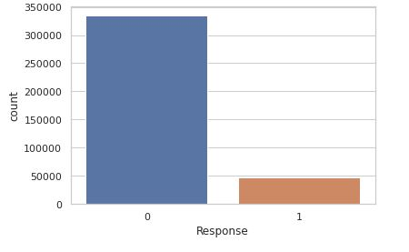
Analysis of Response and Count

Slide 8
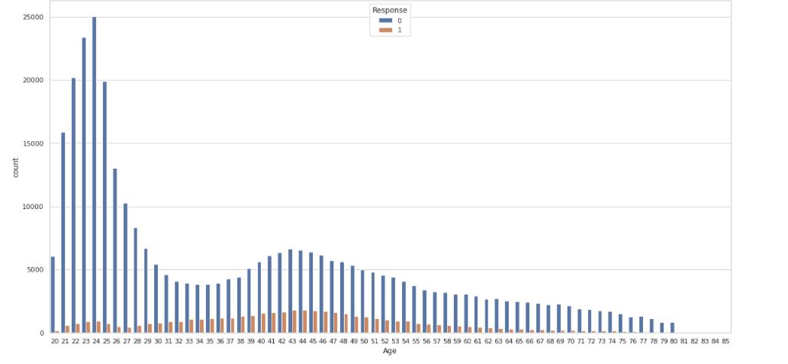
Analysis of Age vs Response

Slide 9
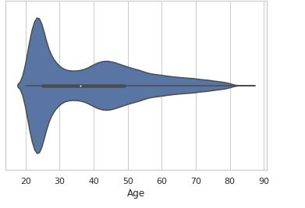
Analysis of Age

Slide 10
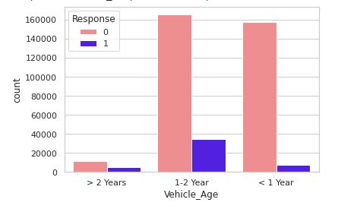
Analysis of Vehicle_Age w.r.t Response

Slide 11
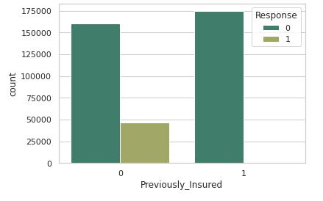
Analysis :Previously_Insured w.r.t Response

Slide 12
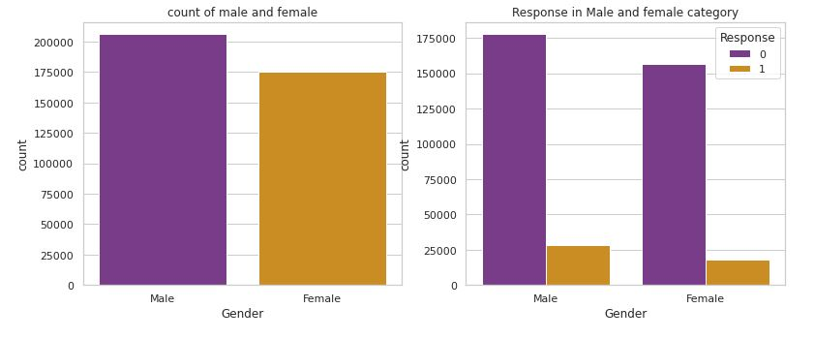
Analysis based on Gender

Slide 13
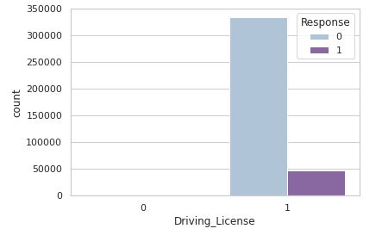
Analysis on Driving License

Slide 14
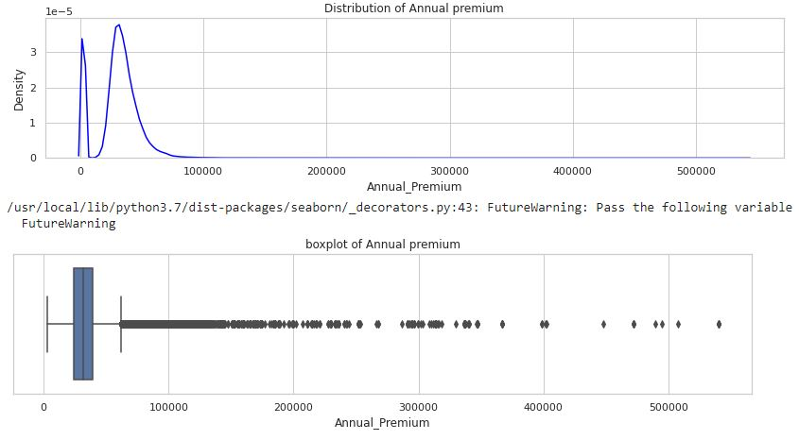
Analysis based on Annual_Premium

Slide 15
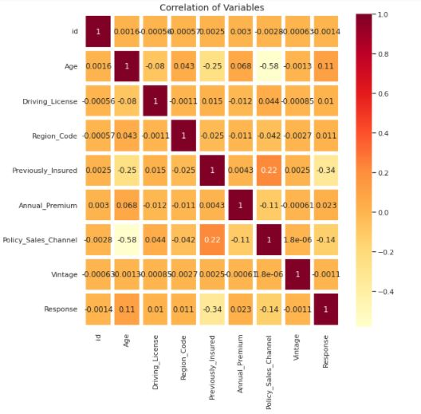
Defining Correlation

Slide 16
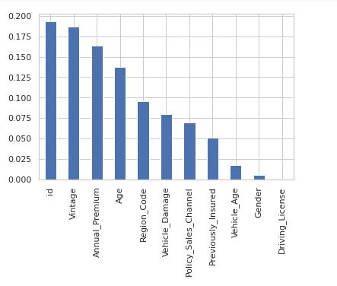
Feature Selection

Slide 17
Model selection and fitting
The Problem can be identified as Binary Classification such as whether consumer purchases vehicle insurance or not.
Data contains more than 300000 information or variables.
It’s smarter way to stay away from SVM Classifier because takes more time to train as the dataset increases.

Slide 18
Fitting of Models
Logistic regression model
Random forest classifier
XGBoost Classifier

Slide 19
Challenges
Data set was not easy to understand and manipulate.
Challenging to identify and fit the right model for tha data due to the problem is Binary nature.
Identifiyng the key factors and deciding best fit models after getting results of models.
We were unable to do visualisation and fitting of model easily due to bulk and running models were taking lot of time.

Slide 20
CONCLUSION
Customers aged between 30 to 60 are more likely to buy insurance.
Youngsters under 30 are not intrigued by vehicle insurance. Reasons could be the absence of involvement, less awareness about insurance and they may not have costly vehicles yet.
Consumers with 1-2-year-old vehicles are more interested as compared to others.
Consumers with less than 1-year-old Vehicles have very less chance of buying Insurance
Customers with Driving License have a higher chance of buying Insurance.
Customers with Vehicle_Damage are likely to buy insurance.
The male category is somewhat more noteworthy than that of females and chances of purchasing the insurance are likewise minimally high.
The variable such as Age, Previously_insured, Annual_premium is more affecting the target variable.
Comparing the ROC curve we can see that the Random Forest model performs better. Because curves closer to the top-left corner indicate better performance.

